Slide 1


Embedded Systems Design
Chapter 9: Digital I/O
9.1 The MSP430 Digital I/O System
Brock J. LaMeres, Ph.D.

Slide 2
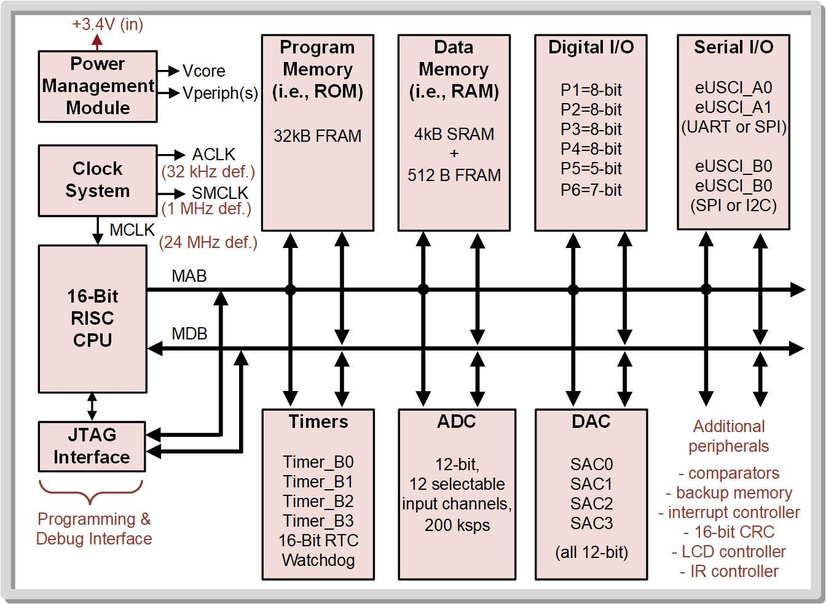
Ch. 9: The MSP430 Digital I/O System
9.1 The MSP430 Digital I/O System
Digital I/O
=
Parallel Ports
P1, P2, P3, P4, P5, P6
PA=P1:P2
PB=P3:P4
PC=P5:P6
9.1 The MSP430 Digital I/O System

Slide 3
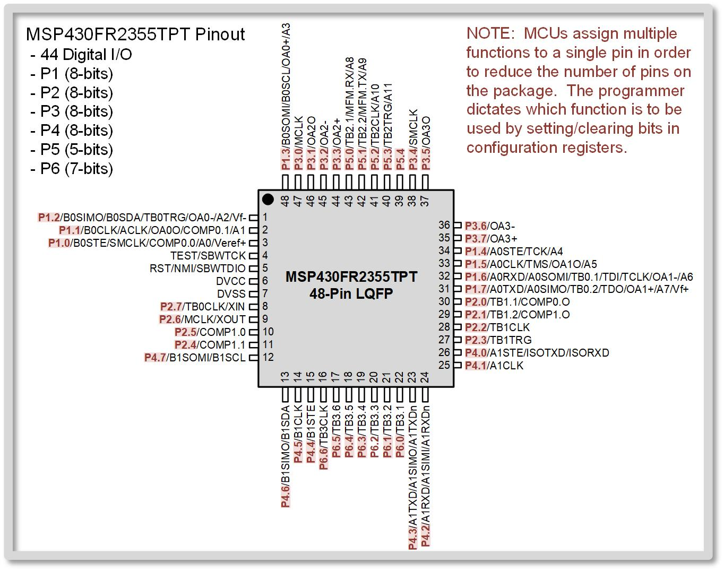
Ch. 9: The MSP430 Digital I/O System
9.1 The MSP430 Digital I/O System
Recall that the MCUs share functionality on pins in order to reduce the size and cost of the device.
9.1 The MSP430 Digital I/O System

Slide 4
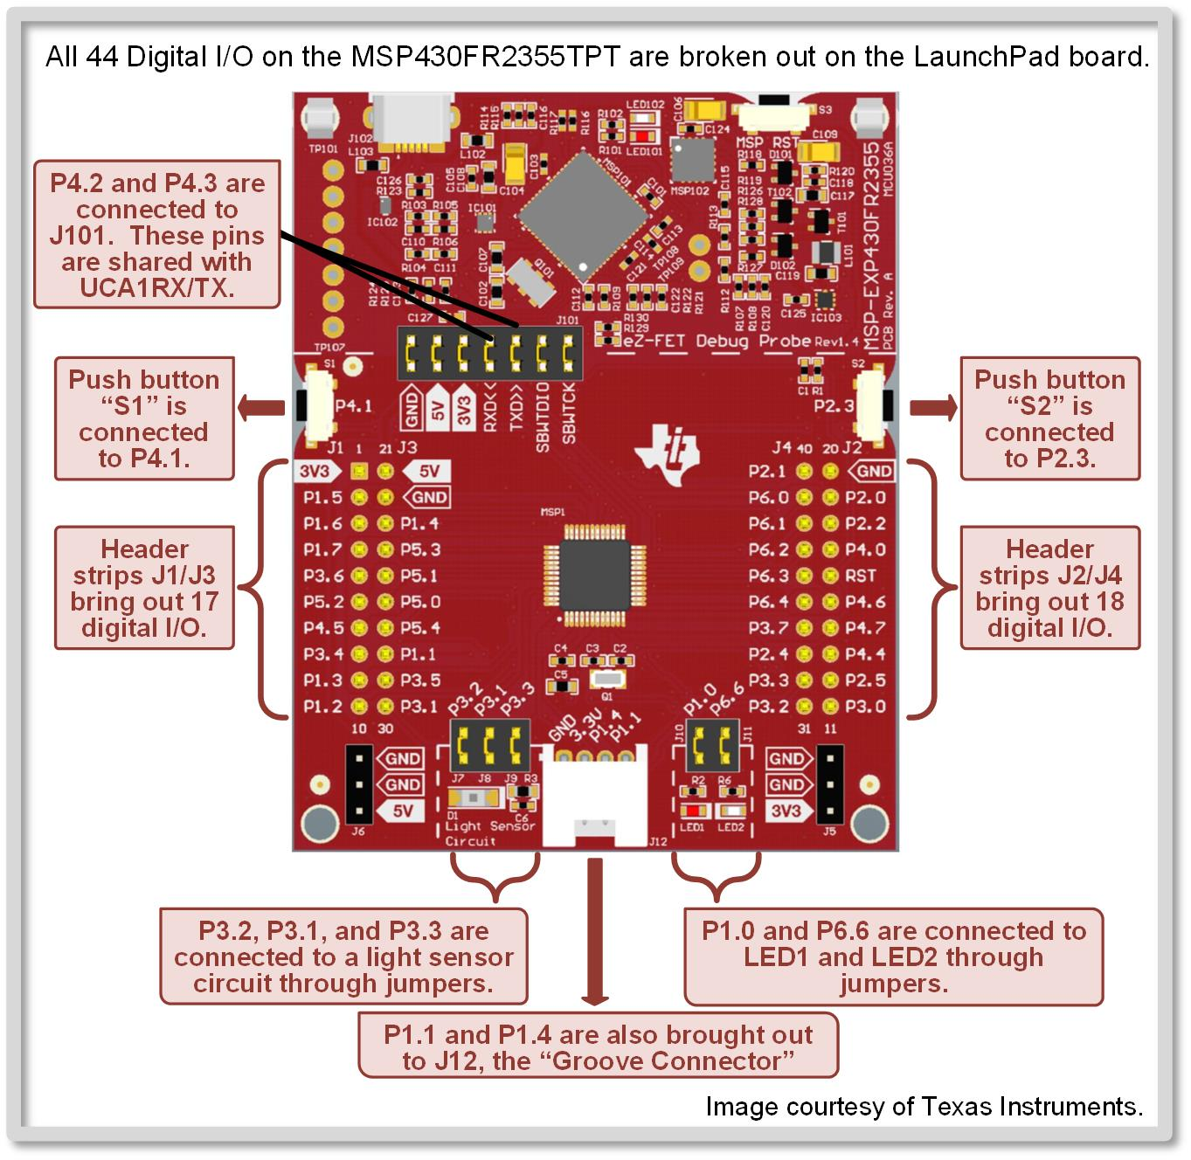
Ch. 9: The MSP430 Digital I/O System
9.1 The MSP430 Digital I/O System
This figure shows the details of the MCU digital I/O breakout on the LaunchpadTM
Image Courtesy of
Recording Connection of Canada
9.1 The MSP430 Digital I/O System

Slide 5
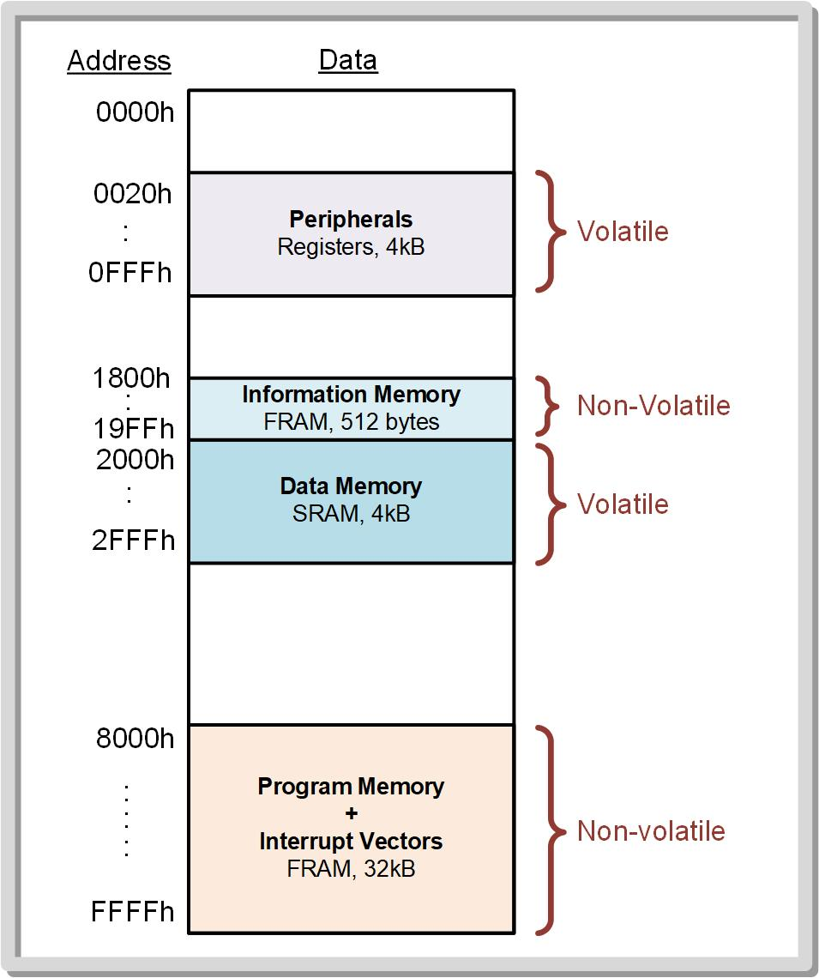
Ch. 9: The MSP430 Digital I/O System
9.1.1 Configuration Registers
Peripherals are setup and interfaced with using registers within the memory map.
Bit Set and Bit Clear instructions are used to configure the registers.
9.1 The MSP430 Digital I/O System

Slide 6
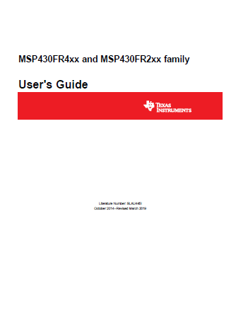
Ch. 9: The MSP430 Digital I/O System
9.1.1 Configuration Registers – Documentation
The MSP430FRxx Family User’s Guide gives the name and purpose of each register.
9.1 The MSP430 Digital I/O System

Slide 7
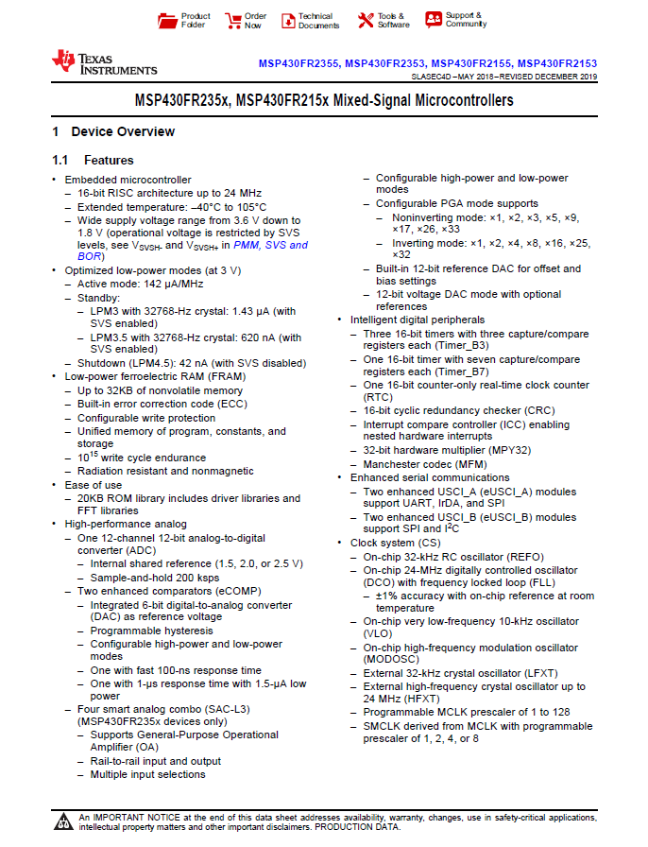
Ch. 9: The MSP430 Digital I/O System
9.1.1 Configuration Registers – Documentation
The MSP430 Device Specific Datasheet gives the details of which peripherals are available, which pin they are on, and how to select the function.
9.1 The MSP430 Digital I/O System

Slide 8
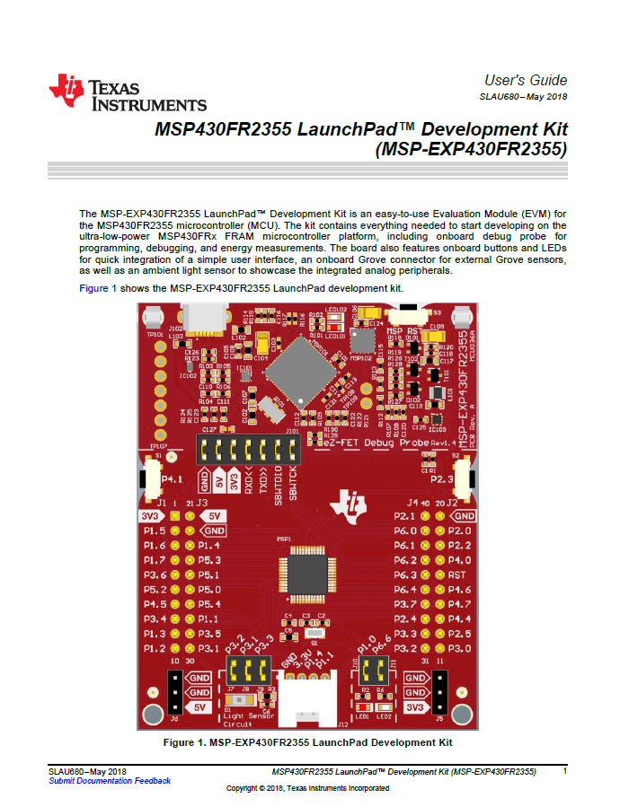
Ch. 9: The MSP430 Digital I/O System
9.1.1 Configuration Registers – Documentation
The LaunchPad Development Kit User’s Guide tells where the I/O are connected on the red board.
9.1 The MSP430 Digital I/O System

Slide 9

Ch. 9: The MSP430 Digital I/O System
9.1.1 Port Direction Registers (PxDIR)
The port direction registers dictate whether the port bits are configured as inputs or outputs.
The logic for PxDIR is as follows:
Bit = 0: Pin is an input (default)
Bit = 1: Pin is an output
Image Courtesy of https://neodem.wp.horizon.ac.uk/
Image Courtesy of
Recording Connection of Canada
9.1 The MSP430 Digital I/O System

Slide 10
Ch. 9: The MSP430 Digital I/O System
9.1.2 Port Input Registers (PxIN)
Each bit within PxIN registers represent the logic levels at the input signals pins.
Bit = 0: Logic low Bit = 1: Logic high
Read only registers
In order to read from an input port bit, a program can either move the information into a CPU register, or do bit compares on the PxIN memory location.
Image Courtesy of https://neodem.wp.horizon.ac.uk/
Image Courtesy of
Recording Connection of Canada
Image Courtesy of
Recording Connection of Canada
9.1 The MSP430 Digital I/O System

Slide 11
Ch. 9: The MSP430 Digital I/O System
9.1.3 Port Output Registers (PxOUT)
Each bit within the PxOUT registers is the value to be output to the port’s signal pin when the bit is configured to be an output.
In order to write to an output port bit, a program can move information into the PxOUT register, or perform bit set/clear operations on the PxOUT address location.
When a port bit is configured as an input, the PxOUT register has a secondary role, which is to dictate the polarity of an optional pull-up/down resistor.
Image Courtesy of https://neodem.wp.horizon.ac.uk/
Image Courtesy of
Recording Connection of Canada
Image Courtesy of
Recording Connection of Canada
Image Courtesy of
Recording Connection of Canada
9.1 The MSP430 Digital I/O System

Slide 12
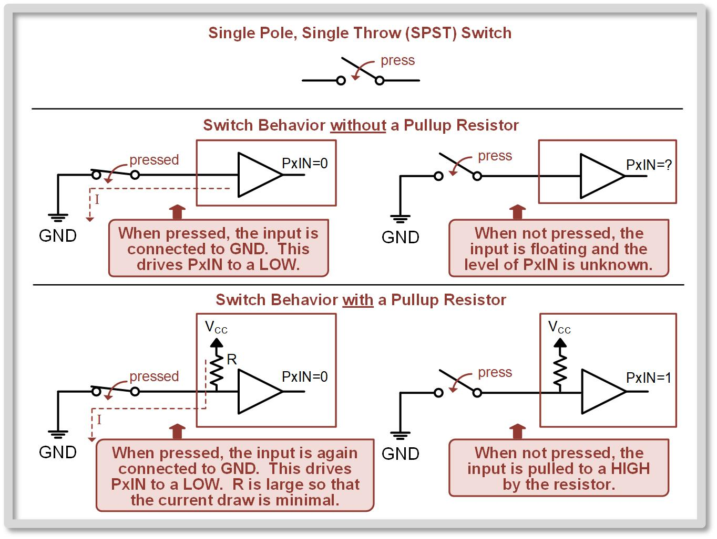
Ch. 9: The MSP430 Digital I/O System
9.1.4 Port Pullup/Pulldown Register Enable Registers (PxREN)
If a port is an input, an optional pull-up or pull-down resistor can be attached.
The bits within PxREN control the corresponding bit location within PxIN.
The resistor resides in the MCU.
Bit = 0: Disabled Bit = 1: Enabled
Gnd
Image Courtesy of https://neodem.wp.horizon.ac.uk/
Image Courtesy of
Recording Connection of Canada
Image Courtesy of
Recording Connection of Canada
Image Courtesy of
Recording Connection of Canada
Image Courtesy of
Recording Connection of Canada
9.1 The MSP430 Digital I/O System

Slide 13
Ch. 9: The MSP430 Digital I/O System
9.1.4 Port Pullup/Pulldown Register Enable Registers (PxREN)
Pull-up and pull-down resistors are typically very large (10kΩ → 1MΩ) so that external circuitry can easily override them.
But the pull-up resistors are “just” strong enough that when nothing is driving the pin, it will pull them to a known logic level (HIGH or LOW).
Gnd
Image Courtesy of https://neodem.wp.horizon.ac.uk/
Image Courtesy of
Recording Connection of Canada
Image Courtesy of
Recording Connection of Canada
Image Courtesy of
Recording Connection of Canada
Image Courtesy of
Recording Connection of Canada
9.1 The MSP430 Digital I/O System

Slide 14
Ch. 9: The MSP430 Digital I/O System
9.1.4 Port Pullup/Pulldown Register Enable Registers (PxREN)
To configure whether the resistor is a pull UP or pull DOWN, the PxOUT register is used. PxOUT = 0: Resistor is a Pull Down PxOUT = 1: Resistor is a Pull Up
Gnd
Image Courtesy of https://neodem.wp.horizon.ac.uk/
Image Courtesy of
Recording Connection of Canada
Image Courtesy of
Recording Connection of Canada
Image Courtesy of
Recording Connection of Canada
Image Courtesy of
Recording Connection of Canada
9.1 The MSP430 Digital I/O System

Slide 15
Ch. 9: The MSP430 Digital I/O System
9.1.4 An Example of Using the Pull Up/Down Resistors
Single-pole, single-throw (SPST) switch/button – simplest form of a switch, one input and one output
When the switch is open, the input and output are not connected.
When the switch is closed, the input and output are connected.
9.1 The MSP430 Digital I/O System

Slide 16
Ch. 9: The MSP430 Digital I/O System
9.1.4 An Example of Using the Pull Up/Down Resistors
Adding a pull-up resistor connected to the power supply can provide a logic high when the switch is open.
This takes two steps:
PxREN = 1 (enable the resistor)
PxOUT = 1 (make it a pull UP)
9.1 The MSP430 Digital I/O System

Slide 17

Ch. 9: The MSP430 Digital I/O System
9.1.5 Port Function Select Registers
(PxSEL1 and PxSEL0)
The Port Function Select (PxSEL) registers tell the MCU which function to use, including whether to make the signal pin a digital input/output.
PxSEL1 and PxSEL0 hold the two selection bit.
The function is found in the Device Specific Datasheet
9.1 The MSP430 Digital I/O System

Slide 18
Ch. 9: The MSP430 Digital I/O System
9.1.6 Digital I/O Enabling After Reset
The steps to fully set up a digital I/O for use can be summarized in the following steps:
Initialize Configuration Registers: PxDIR, PxREN, PxOUT if applicable, and PxSEL1: PxSEL0.
Clear the LOCKLPM5 bit in the PM5CTL0 register (low power, high-Z input mode by default)
Your program may now start using the PxIN or PxOUT register.
Image Courtesy of https://neodem.wp.horizon.ac.uk/
Image Courtesy of
Recording Connection of Canada
Image Courtesy of
Recording Connection of Canada
Image Courtesy of
Recording Connection of Canada
Image Courtesy of
Recording Connection of Canada
Image Courtesy of
Recording Connection of Canada
9.1 The MSP430 Digital I/O System

Slide 19

Embedded Systems Design
Chapter 9: Digital I/O
9.1 The MSP430 Digital I/O System
www.youtube.com/c/DigitalLogicProgramming_LaMeres
Brock J. LaMeres, Ph.D.

Slide 20
Embedded Systems Design
Chapter 9: Digital I/O
9.1 The MSP430 Digital I/O System – The MSP430.h Header
Brock J. LaMeres, Ph.D.

Slide 21
Ch. 9: The MSP430 Digital I/O System
9.1.7 Using Literal Definitions from the
MSP430.H Header File
To eliminate the need for the programmer to look up the absolute address of each register within the memory map, Code Composer Studio automatically includes a header file with literal names defined for the memory addresses.
Main header files we will use: msp430.h and msp430fr2355.h
These files contain the exact spelling of the register names and abbreviations of the memory map.
These register names are NOT address labels. They are simply name substitutions. So we need to use absolute addressing: i.e., bis.b #BIT0, &P1DIR
9.1 The MSP430 Digital I/O System

Slide 22
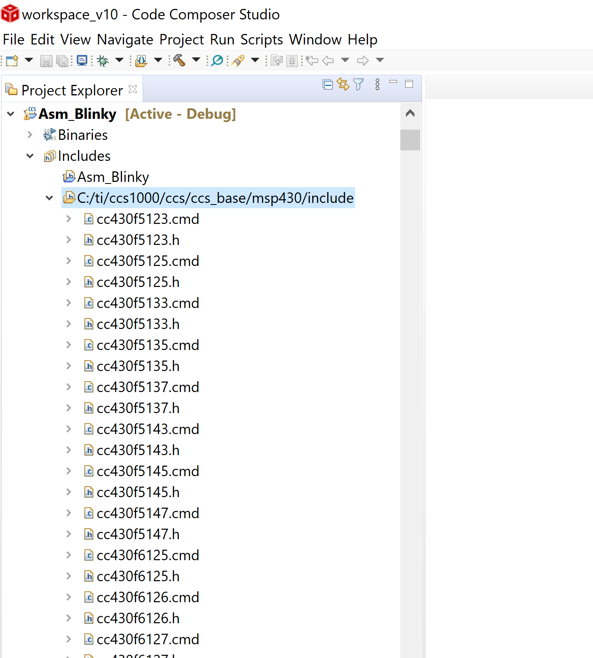
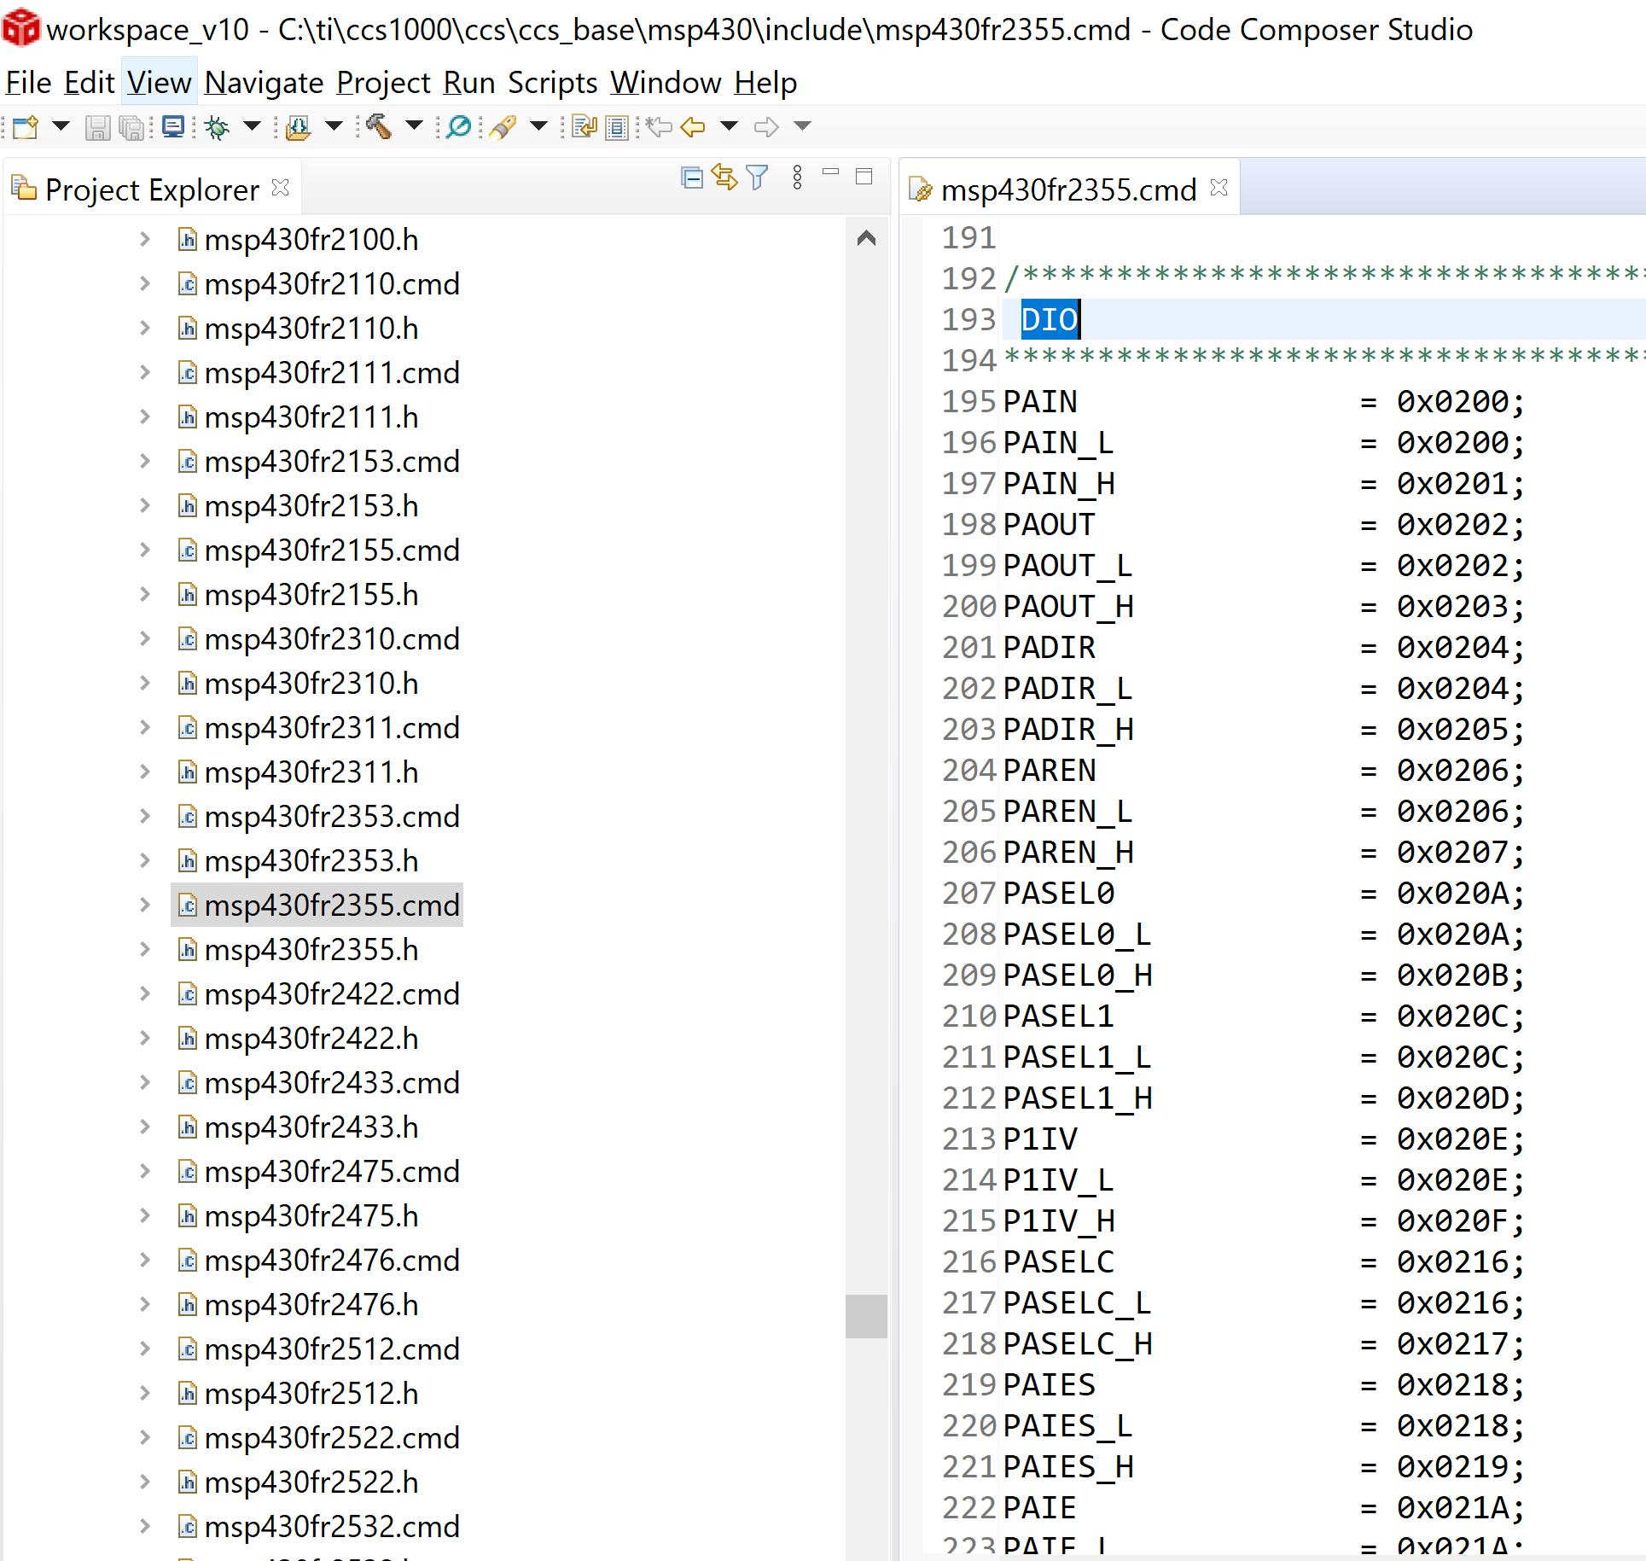
Ch. 9: The MSP430 Digital I/O System
9.1.7 Using Literal Definitions from the
MSP430.H Header File
9.1 The MSP430 Digital I/O System

Slide 23
Embedded Systems Design
Chapter 9: Digital I/O
9.1 The MSP430 Digital I/O System – The MSP430.h Header
www.youtube.com/c/DigitalLogicProgramming_LaMeres
Brock J. LaMeres, Ph.D.

Slide 24
Embedded Systems Design
Chapter 9: Digital I/O
9.2 Digital Output Programming
Image Courtesy of
Recording Connection of Canada
Brock J. LaMeres, Ph.D.

Slide 25
Ch. 9: The MSP430 Digital I/O System
Digital Output Program
Initialize Configuration Registers:
P1DIR bit 0 = 1 ;Configure P1.0 as an OUTPUT
Clear LOCKLPM5 in PM5CTL0 register
Using the names defined in the header file, the assembly code to accomplish this configuration is:
Image Courtesy of https://neodem.wp.horizon.ac.uk/
Image Courtesy of
Recording Connection of Canada
Image Courtesy of
Recording Connection of Canada
Image Courtesy of
Recording Connection of Canada
Image Courtesy of
Recording Connection of Canada
Image Courtesy of
Recording Connection of Canada
Image Courtesy of
Recording Connection of Canada
Image Courtesy of
Recording Connection of Canada
9.2 Digital Output Programming

Slide 26
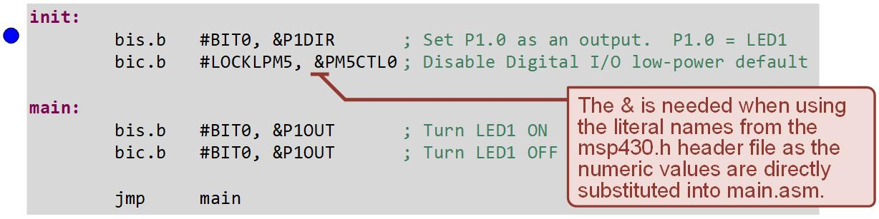
Ch. 9: The MSP430 Digital I/O System
Example: Using a Digital Output to Drive LED1
Step 1: Create a new Empty Assembly-only CCS project titled:
Asm_Dig_IO_Outputs_n_LEDs
Step 2: Type in the following code into the main.asm file where the comments say “Main loop here.”
9.2 Digital Output Programming

Slide 27
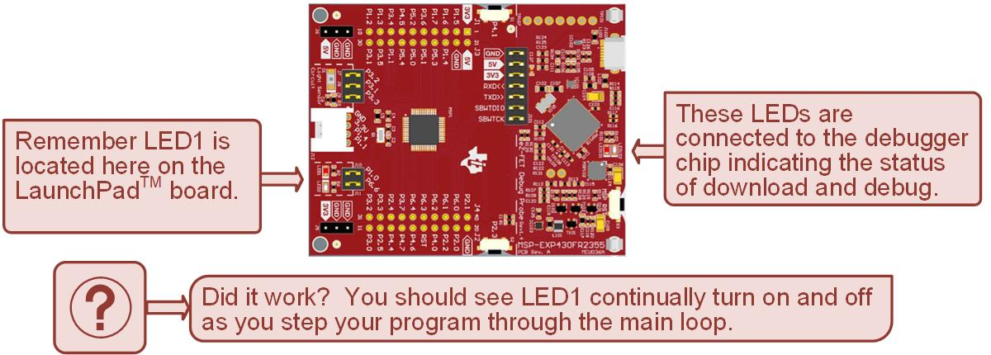
Ch. 9: The MSP430 Digital I/O System
Example: Using a Digital Output to Drive LED1
Step 3: Debug your program.
Step 4: Set a breakpoint before the first instruction
bis.b #BIT0, P1DIR
Image Courtesy of https://neodem.wp.horizon.ac.uk/
Image Courtesy of
Recording Connection of Canada
Image Courtesy of
Recording Connection of Canada
Image Courtesy of
Recording Connection of Canada
Image Courtesy of
Recording Connection of Canada
Image Courtesy of
Recording Connection of Canada
Image Courtesy of
Recording Connection of Canada
Image Courtesy of
Recording Connection of Canada
9.2 Digital Output Programming

Slide 28
Ch. 9: The MSP430 Digital I/O System
Example: Using a Digital Output to Drive LED1
Step 5: Run your program to the breakpoint.
Step 6: Step your program to observe its operation.
Image Courtesy of https://neodem.wp.horizon.ac.uk/
Image Courtesy of
Recording Connection of Canada
Image Courtesy of
Recording Connection of Canada
Image Courtesy of
Recording Connection of Canada
Image Courtesy of
Recording Connection of Canada
Image Courtesy of
Recording Connection of Canada
Image Courtesy of
Recording Connection of Canada
Image Courtesy of
Recording Connection of Canada
9.2 Digital Output Programming

Slide 29
Ch. 9: The MSP430 Digital I/O System
Tips and Tricks
The port registers may be viewed during the debug process.
When the digital I/O is not configured correctly, the result is that the I/O pin simply does nor work.
When this occurs, the only way to figure out what is going on is to go into the Register Viewer and make sure the configuration registers are set up as desired.
Image Courtesy of https://neodem.wp.horizon.ac.uk/
Image Courtesy of
Recording Connection of Canada
Image Courtesy of
Recording Connection of Canada
Image Courtesy of
Recording Connection of Canada
Image Courtesy of
Recording Connection of Canada
Image Courtesy of
Recording Connection of Canada
Image Courtesy of
Recording Connection of Canada
Image Courtesy of
Recording Connection of Canada
9.2 Digital Output Programming

Slide 30
Ch. 9: The MSP430 Digital I/O System
Example: Viewing Port Registers in the Debugger
Step 1: Open the project from the last example titled Asm_Dig_IO_Outputs_n_LEDs. If you didn’t do the last example, create a new Empty Assembly-only CCS project of this name.
Step 2: If necessary, type in the following code into the main.asm file where the comments say “Main loop here.”
9.2 Digital Output Programming

Slide 31
Ch. 9: The MSP430 Digital I/O System
Example: Viewing Port Registers in the Debugger
Step 3: Debug your program.
Step 4: Set a breakpoint before the first instruction
bis.b #BIT0, P1DIR
Step 5: Run to the breakpoint.
9.2 Digital Output Programming

Slide 32
Ch. 9: The MSP430 Digital I/O System
Example: Viewing Port Registers in the Debugger
Step 6: Open the Register Viewer and scroll down.
Step 7: Expand the P1 register. You will see all of the configuration registers for this port and their current settings.
Step 8: Change the format to binary. Note that there are additional configuration registers for P1 that have not been covered yet.
Image Courtesy of https://neodem.wp.horizon.ac.uk/
9.2 Digital Output Programming

Slide 33
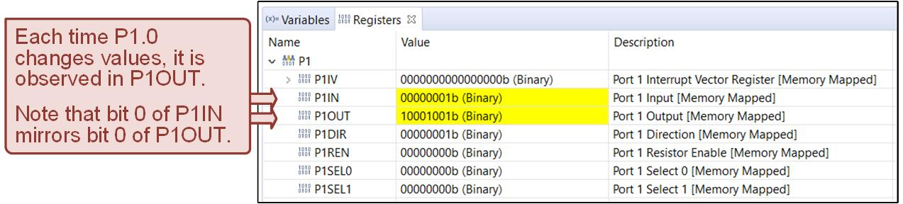
Ch. 9: The MSP430 Digital I/O System
Example: Viewing Port Registers in the Debugger
Step 9: Step your program through the main loop and observe how P1.0 is set and cleared and how this corresponds to LED1 turning on and off.
Image Courtesy of https://neodem.wp.horizon.ac.uk/
Image Courtesy of
Recording Connection of Canada
Image Courtesy of
Recording Connection of Canada
Image Courtesy of
Recording Connection of Canada
Image Courtesy of
Recording Connection of Canada
Image Courtesy of
Recording Connection of Canada
Image Courtesy of
Recording Connection of Canada
Image Courtesy of
Recording Connection of Canada
9.2 Digital Output Programming

Slide 34

Ch. 9: The MSP430 Digital I/O System
Example: Viewing Port Registers in the Debugger
Step 10: Now manually enter 1’s and 0’s for P1.0 in the P1OUT register.
Step 11: After each entry, hit return. Notice that LED1 turns on and off based on your entry. This is a helpful technique to ensure that the configuration registers are correct and that the LaunchPad™ is working as expected.
Image Courtesy of https://neodem.wp.horizon.ac.uk/
Image Courtesy of
Recording Connection of Canada
Image Courtesy of
Recording Connection of Canada
Image Courtesy of
Recording Connection of Canada
Image Courtesy of
Recording Connection of Canada
Image Courtesy of
Recording Connection of Canada
Image Courtesy of
Recording Connection of Canada
Image Courtesy of
Recording Connection of Canada
9.2 Digital Output Programming

Slide 35

Embedded Systems Design
Chapter 9: Digital I/O
9.2 Digital Output Programming
www.youtube.com/c/DigitalLogicProgramming_LaMeres
Image Courtesy of
Recording Connection of Canada
Brock J. LaMeres, Ph.D.

Slide 36
Embedded Systems Design
Chapter 9: Digital I/O
9.3 Digital Input Programming
Image Courtesy of
Recording Connection of Canada
Brock J. LaMeres, Ph.D.

Slide 37
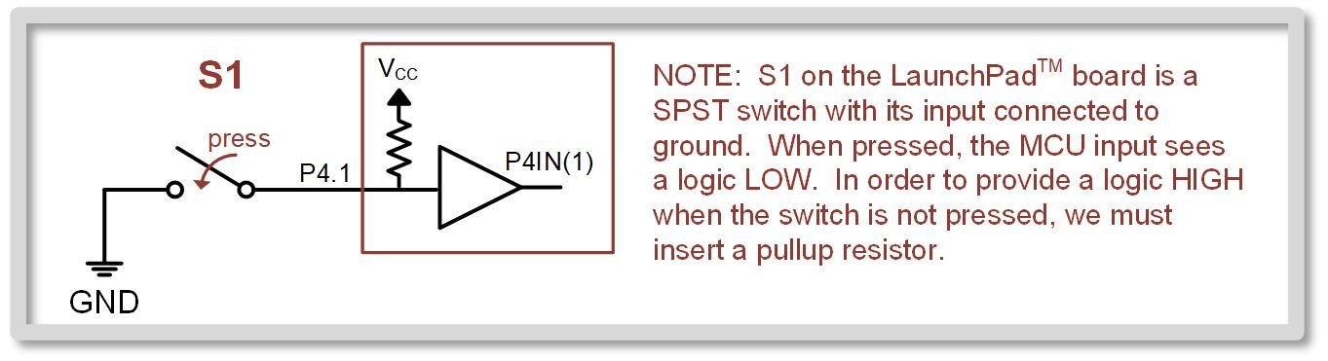
Ch. 9: The MSP430 Digital I/O System
9.3 Digital Input Programming
There are two push-button switches provided on the LaunchPad™ board labeled S1(P4.1) and S2(P2.3).
Both push-button switches are SPST with their inputs connected to ground. This provides a logic LOW to the MCU when not pressed.
To use these switches, include pull-up resistors on the MCU to provide a known state when not pressed.
9.3 Digital Input Programming

Slide 38
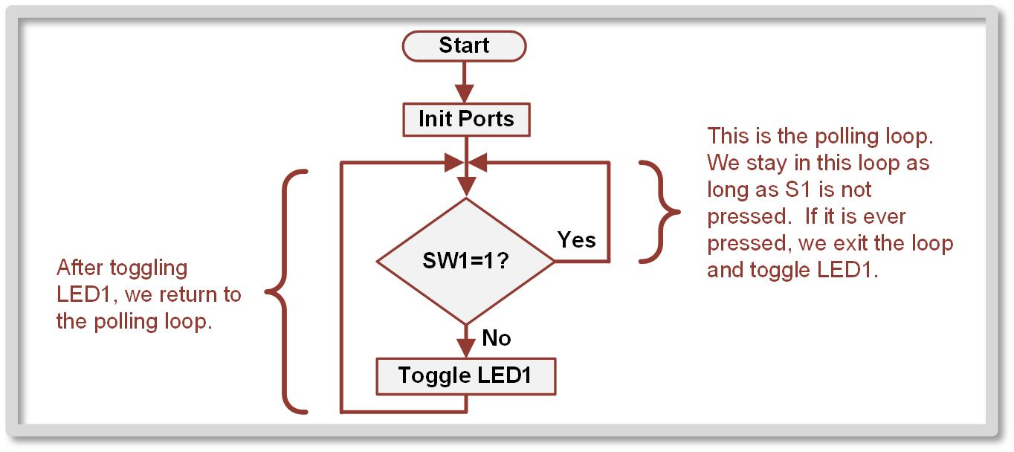
Ch. 9: The MSP430 Digital I/O System
9.3 Digital Input Programming
Polling - creating a program loop that will continually check the value of the input and only exit the loop if the value changes.
9.3 Digital Input Programming

Slide 39
Ch. 9: The MSP430 Digital I/O System
Example: Polling the Input S1
Step 1: Create a new Empty Assembly-only CCS project titled:
Asm_Dig_IO_Inputs_n_Polling_S1
Step 2: Type in the following code into the main.asm file where the comments say “Main loop here.”
Image Courtesy of https://neodem.wp.horizon.ac.uk/
Image Courtesy of
Recording Connection of Canada
Image Courtesy of
Recording Connection of Canada
Image Courtesy of
Recording Connection of Canada
Image Courtesy of
Recording Connection of Canada
Image Courtesy of
Recording Connection of Canada
Image Courtesy of
Recording Connection of Canada
Image Courtesy of
Recording Connection of Canada
9.3 Digital Input Programming

Slide 40
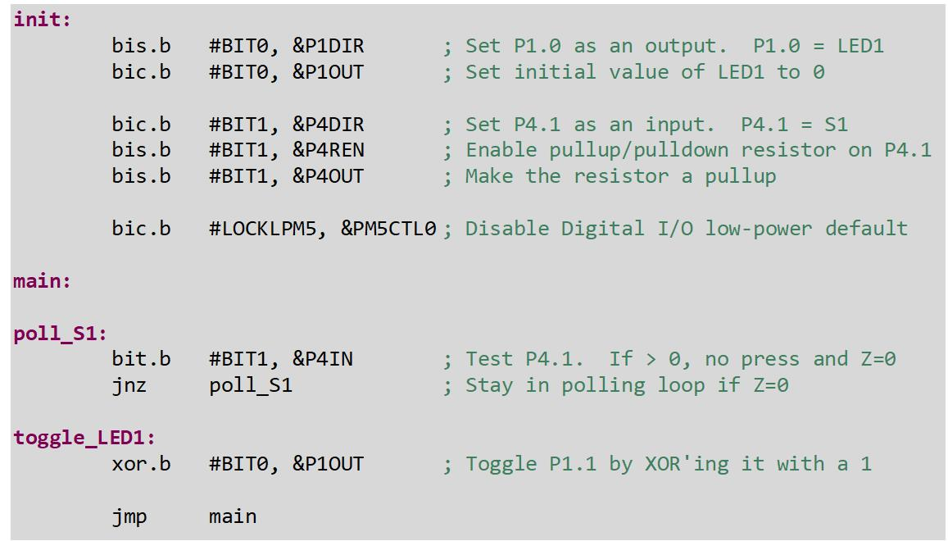
Ch. 9: The MSP430 Digital I/O System
Example: Polling the Input S1
9.3 Digital Input Programming

Slide 41
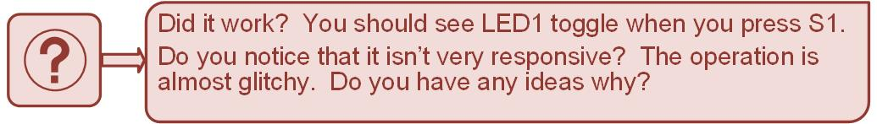
Ch. 9: The MSP430 Digital I/O System
Example: Polling the Input S1
Step 3: Debug your program.
Step 4: Run your program and test whether LED1 toggles when you press SW1.
Image Courtesy of https://neodem.wp.horizon.ac.uk/
9.3 Digital Input Programming

Slide 42
Ch. 9: The MSP430 Digital I/O System
9.3 Digital Input Programming
The reason that LED1 is not always toggled when you press and release S1 is because you can never tell what value LED1 is at when you release the button.
The reason that LED1 appears dimmer when you hold down S1 is because it is being continually turning LED1 on and off millions of times each second while the program checks S1, exists the polling loop, and performs the XOR toggle operation.
Image Courtesy of https://neodem.wp.horizon.ac.uk/
9.3 Digital Input Programming

Slide 43
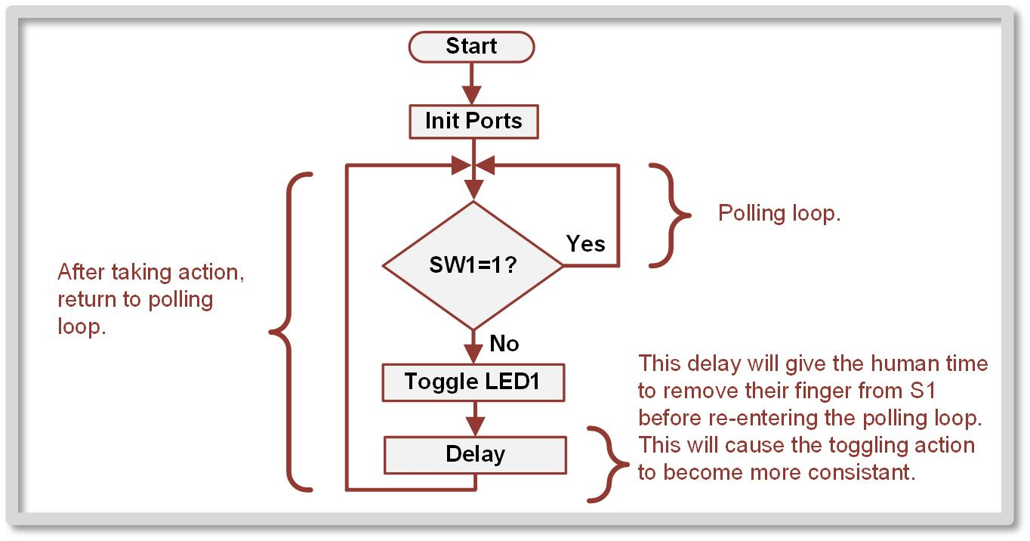
Ch. 9: The MSP430 Digital I/O System
9.3 Digital Input Programming
Consider this new logic for polling S1 that inserts some delay after the LED1 toggling action.
9.3 Digital Input Programming

Slide 44
Ch. 9: The MSP430 Digital I/O System
Example: Polling the Input S1 with Delay
Step 1: Open the project form the last example titled:
Asm_Dig_IO_Inputs_n_Polling_S1
Step 2: Type in the delay portion of the code into the main.asm.
Image Courtesy of https://neodem.wp.horizon.ac.uk/
9.3 Digital Input Programming

Slide 45
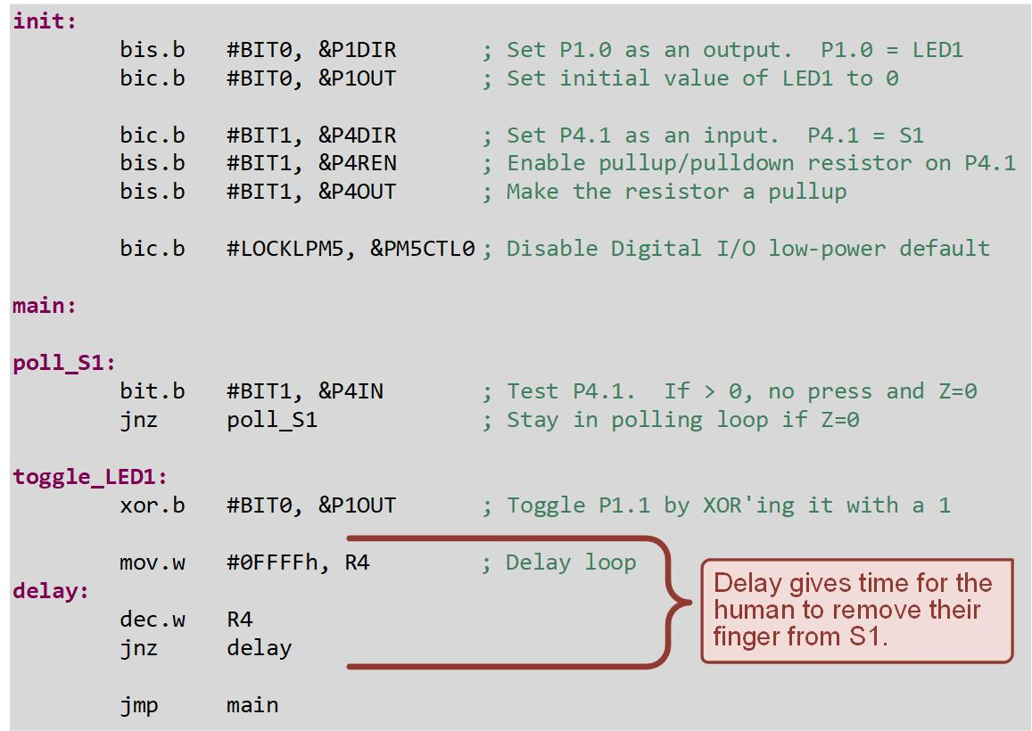
Ch. 9: The MSP430 Digital I/O System
Example: Polling the Input S1 with Delay
9.3 Digital Input Programming

Slide 46
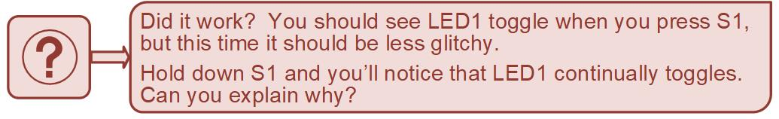
Ch. 9: The MSP430 Digital I/O System
Example: Polling the Input S1
Step 3: Debug your program.
Step 4: Run your program and test whether LED1 toggles when you press SW1 more reliably than before.
Image Courtesy of https://neodem.wp.horizon.ac.uk/
9.3 Digital Input Programming

Slide 47
Embedded Systems Design
Chapter 9: Digital I/O
9.3 Digital Input Programming
www.youtube.com/c/DigitalLogicProgramming_LaMeres
Brock J. LaMeres, Ph.D.

